Slide 1
Marco Polo Travels

Slide 2
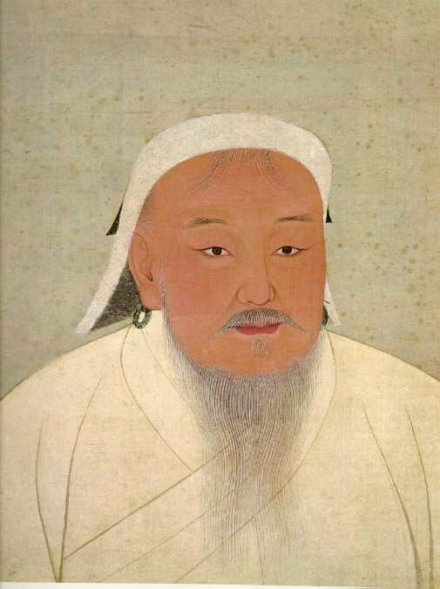
Genghis Khan
(Chinggis Kaan)
(r. 1206 - 1227)
National Palace Museum, Taipei
14th c.

Slide 3
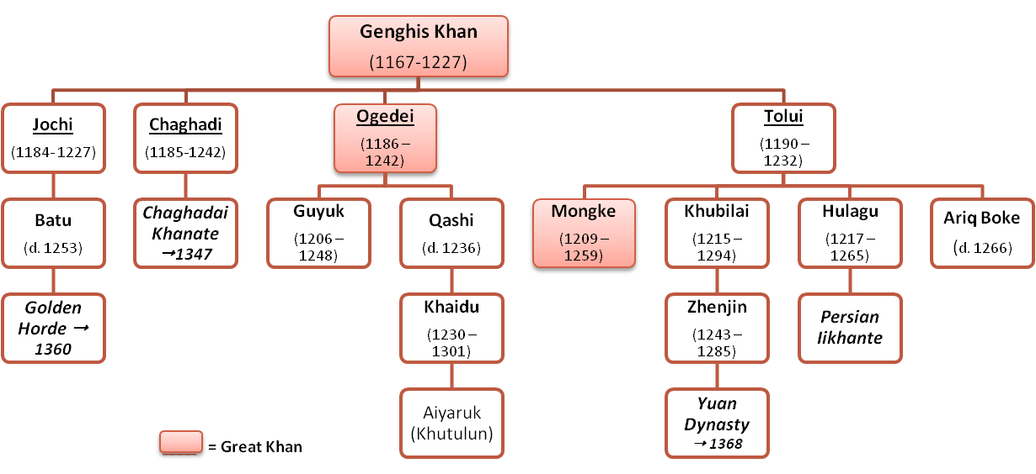
Genghis Khan
Family Tree

Slide 4
Mongol Empire
Territory from 1206-1294

Slide 5
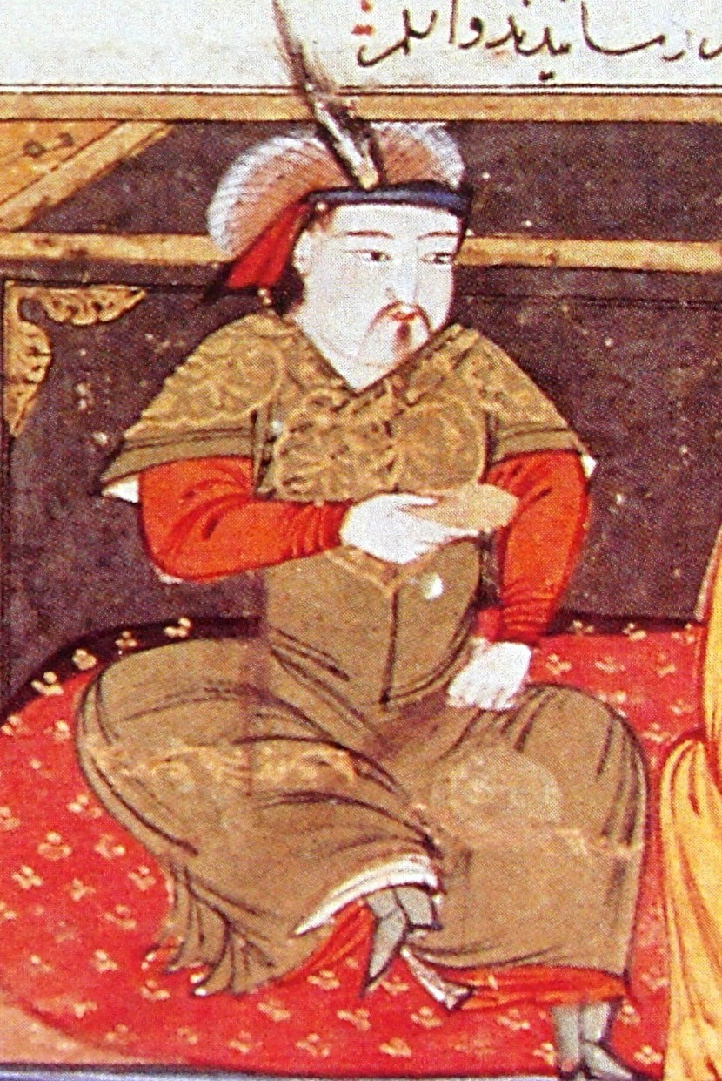
Hulagu Khan
(c. 1218 - 1265)
Rashid-al-Din Hamadani
Early 14th c.

Slide 6
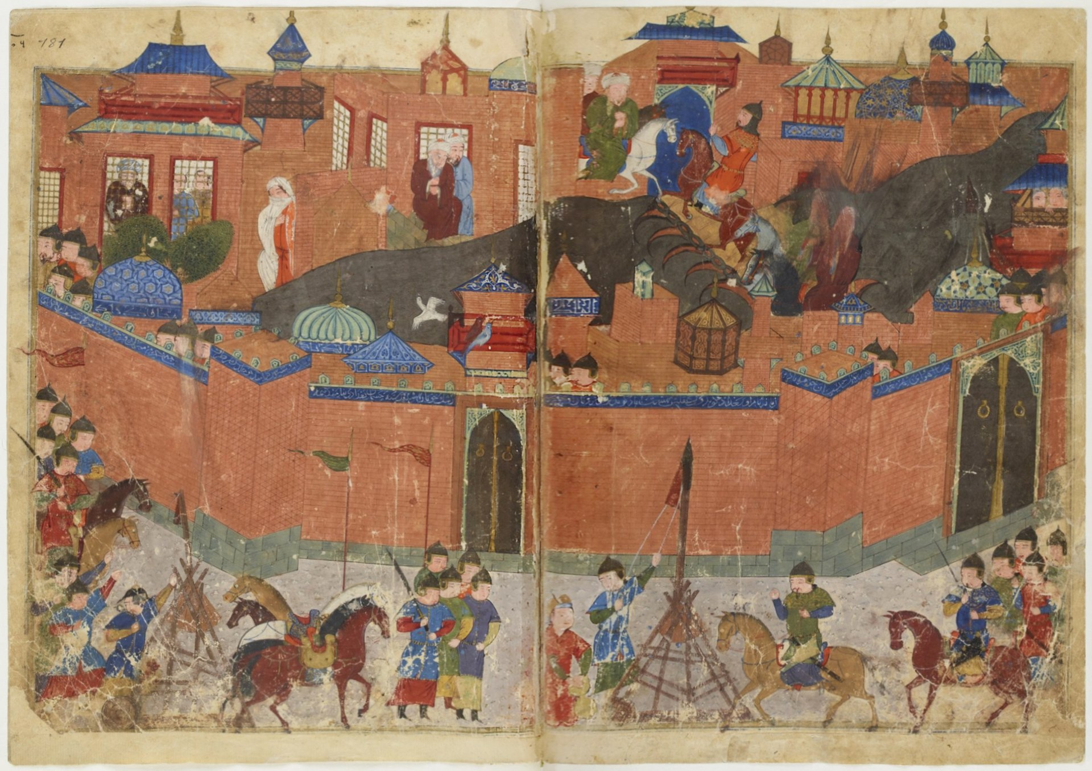
Siege of Baghdad (1258)

Slide 7
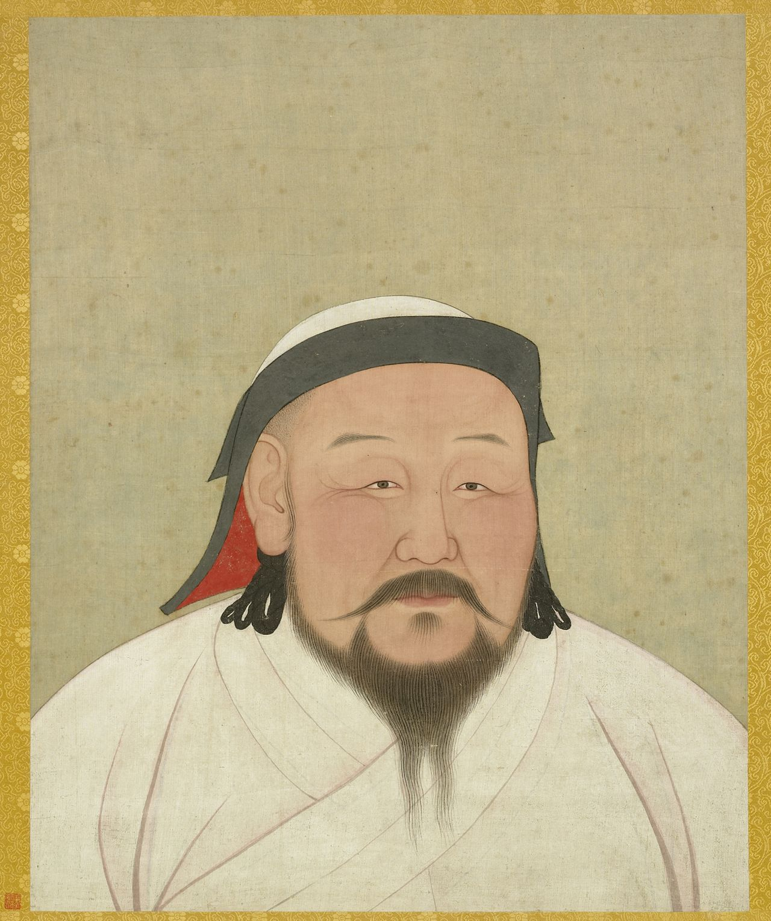
Kublai Khan
(Qubilai/Khubilai)
(r. 1260 - 1294)
Aniko/Araniko (c. 1300)
National Palace Museum, Taipei

Slide 8
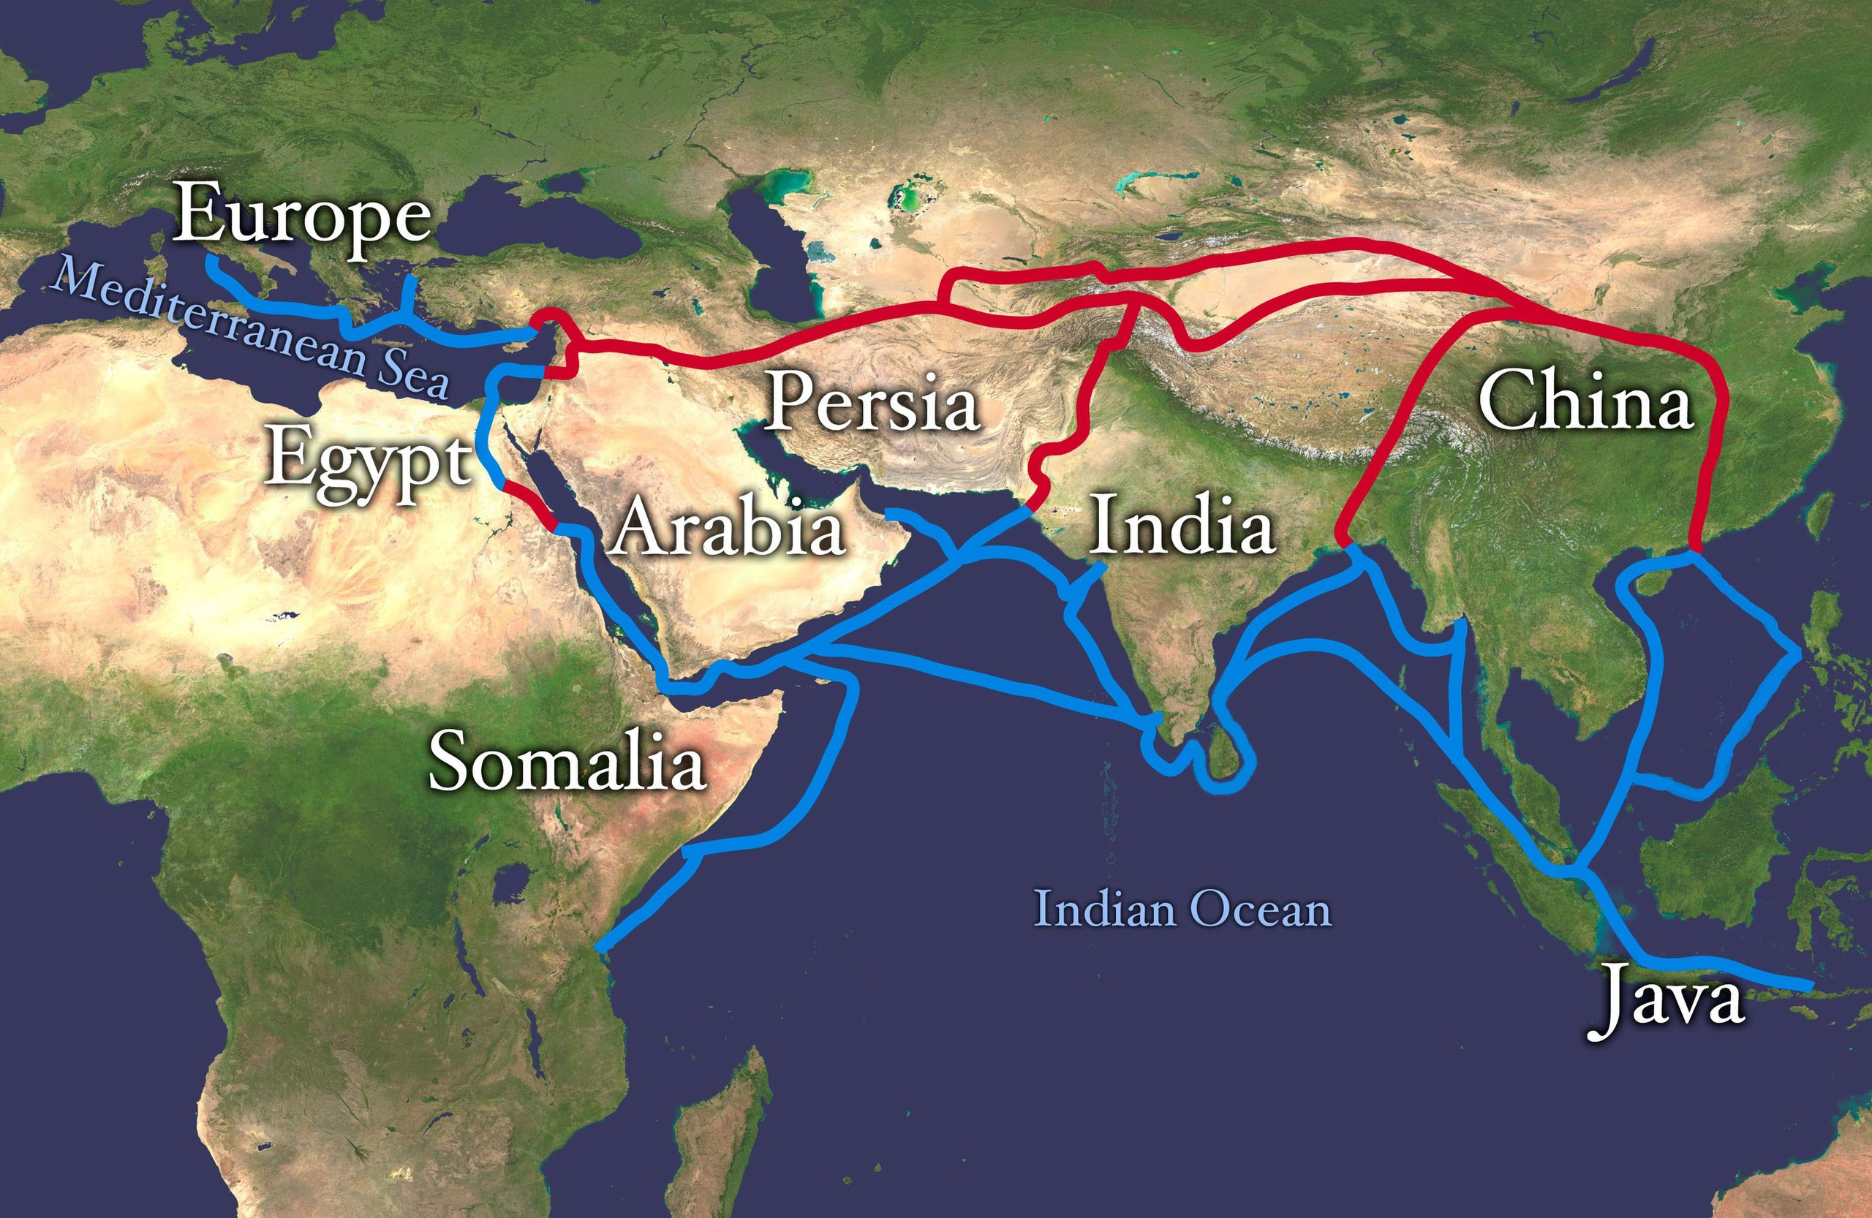
Silk Road
(~2nd c. BCE – 1450s)

Slide 9
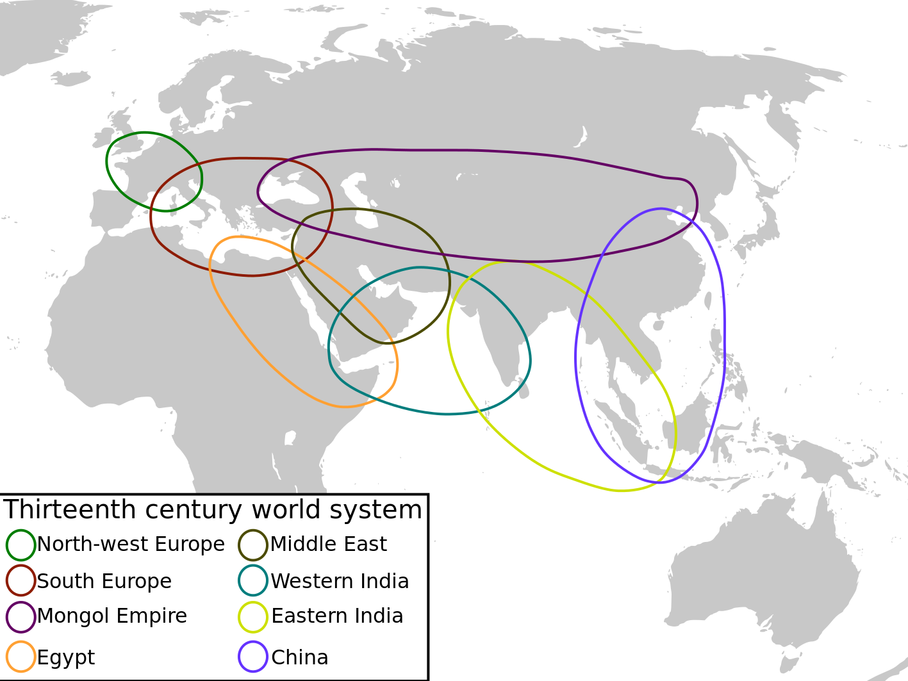
13th Century World Systems

Slide 10
Silk Road
(~2nd c. BCE – 1450s)

Slide 11
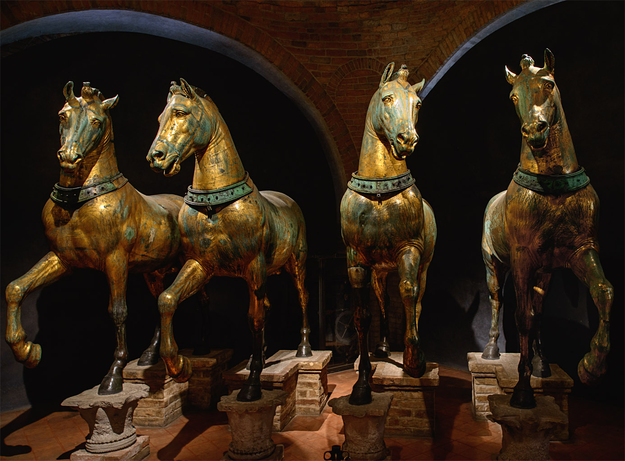
Horses of Saint Mark
(c. 2nd-3rd C)

Slide 12
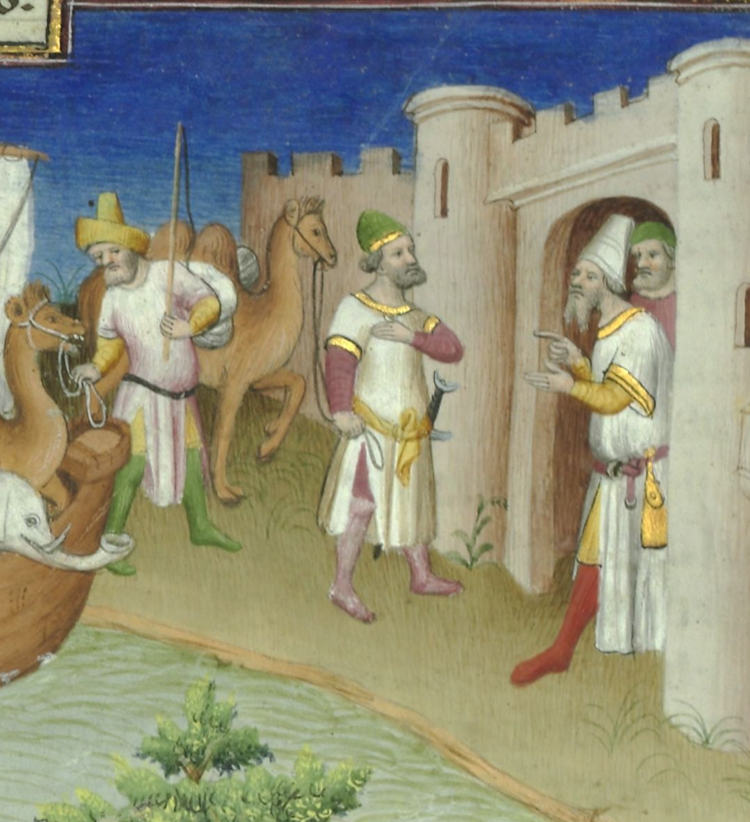
Marco Polo
(1254 – 8 Jan 1328)
Bibliothèque nationale de France
Ms. fr. 2810, fol. 14v

Slide 13
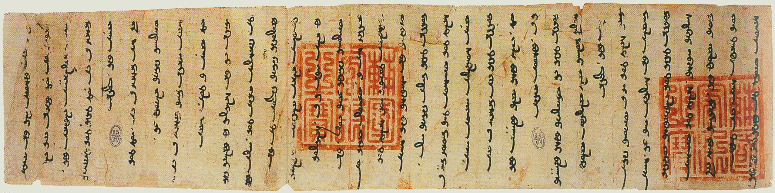
Letter from Arghun Khan to
Pope Nicholas IV, adopting Christianity throughout the Ilkhanate (1290)
Letter in Mongolian language and script, seals (red) in Chinese
Rome, Vatican Archives

Slide 14
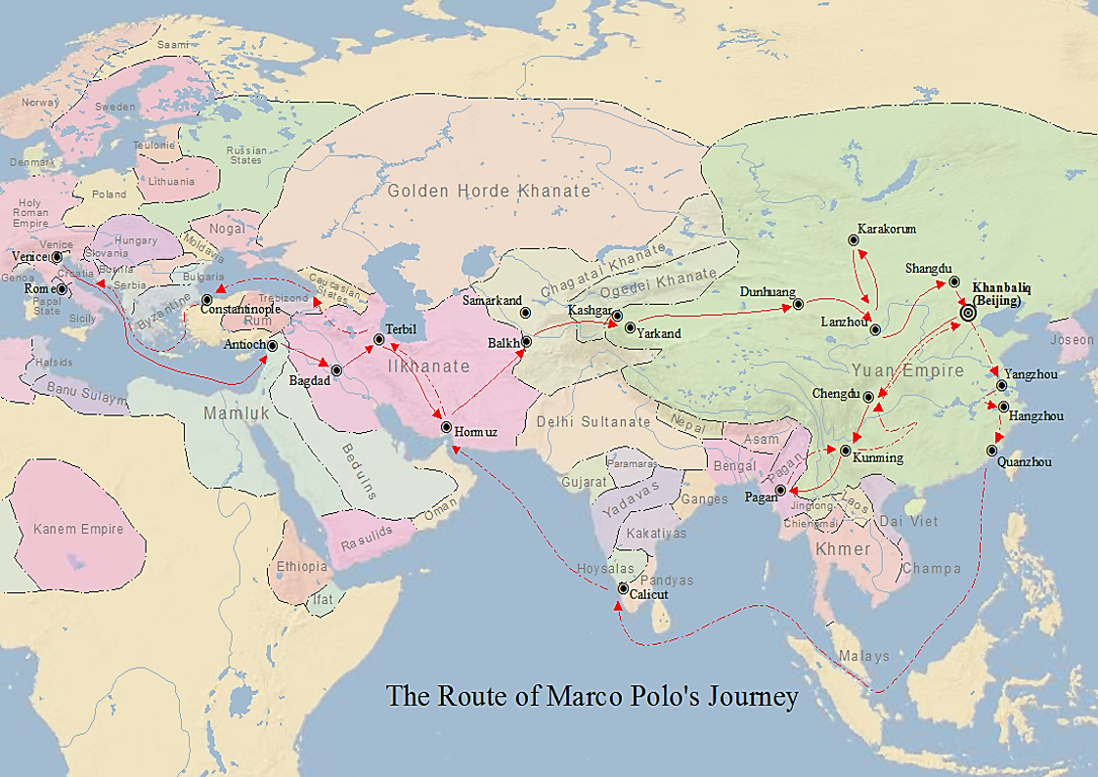
Marco Polo’s Travel Route

Slide 15
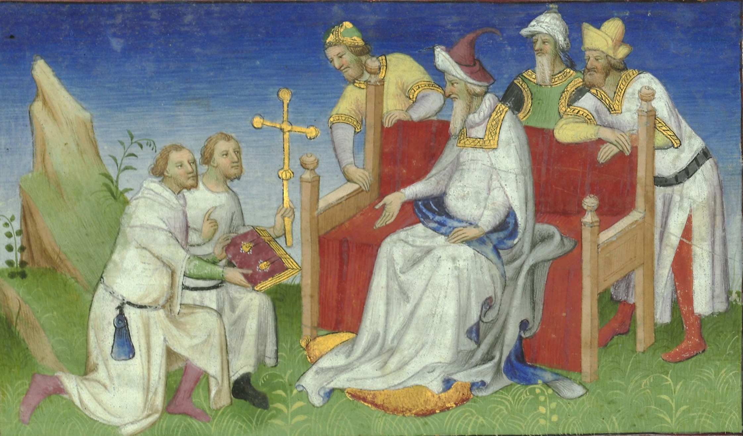
The Polos return to Kublai Khan
Bibliothèque nationale de France

Slide 16
Marco Polo’s Travel Route

Slide 17
Marco Polo Travels (or) Book of the Marvels of the World (or) Description of the World (or) Il Milione

Slide 18


Debating Marco Polo
(1995)
(1999)

